Slide 1
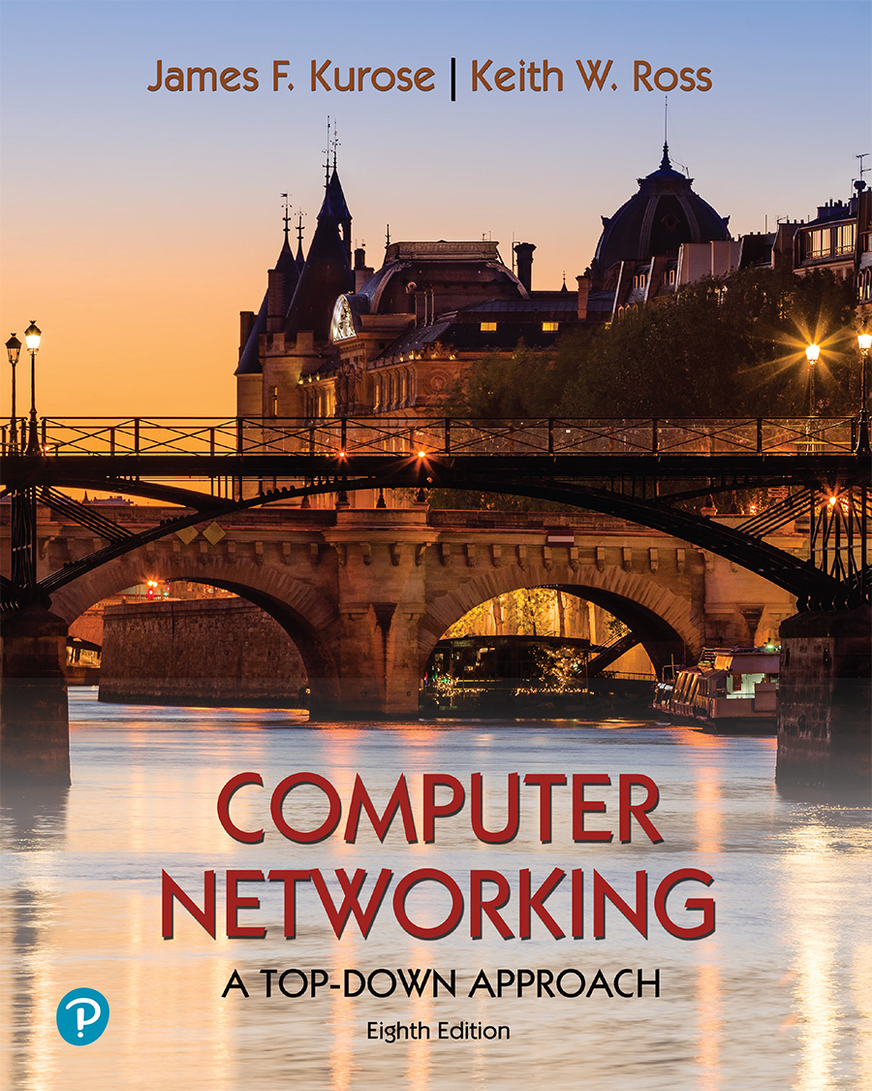
Chapter 8 Security
A note on the use of these PowerPoint slides:
We’re making these slides freely available to all (faculty, students, readers). They’re in PowerPoint form so you see the animations; and can add, modify, and delete slides (including this one) and slide content to suit your needs. They obviously represent a lot of work on our part. In return for use, we only ask the following:
If you use these slides (e.g., in a class) that you mention their source (after all, we’d like people to use our book!)
If you post any slides on a www site, that you note that they are adapted from (or perhaps identical to) our slides, and note our copyright of this material.
For a revision history, see the slide note for this page.
Thanks and enjoy! JFK/KWR
All material copyright 1996-2020
J.F Kurose and K.W. Ross, All Rights Reserved
Computer Networking: A Top-Down Approach 8th edition Jim Kurose, Keith Ross Pearson, 2020
Notes:
Version History
8.0 (May 2020)
All slides reformatted for 16:9 aspect ratio
All slides updated to 8th edition material
Use of Calibri font, rather that Gill Sans MT
Add LOTS more animation throughout
lighter header font
wireless security completely redone (updated WiFi and added 4G/5G)
SSL material replaces by TLS 1.3 (up-to-date)

Slide 2
Security: overview
Chapter goals:
understand principles of network security:
cryptography and its many uses beyond “confidentiality”
authentication
message integrity

Slide 3
What is network security?
confidentiality: only sender, intended receiver should “understand” message contents
sender encrypts message
receiver decrypts message
authentication: sender, receiver want to confirm identity of each other
message integrity: sender, receiver want to ensure message not altered (in transit, or afterwards) without detection
access and availability: services must be accessible and available to users

Slide 4



Friends and enemies: Alice, Bob, Trudy
well-known in network security world
Bob, Alice (lovers!) want to communicate “securely”
Trudy (intruder) may intercept, delete, add messages
Alice
channel
data, control messages
Bob
secure
sender
secure
receiver
data
data
Trudy

Slide 5
Friends and enemies: Alice, Bob, Trudy
Who might Bob and Alice be?
… well, real-life Bobs and Alices!
Web browser/server for electronic transactions (e.g., on-line purchases)
on-line banking client/server
DNS servers
BGP routers exchanging routing table updates
other examples?

Slide 6
There are bad guys (and girls) out there!
Q: What can a “bad guy” do?
A: A lot! (recall section 1.6)
eavesdrop: intercept messages
actively insert messages into connection
impersonation: can fake (spoof) source address in packet (or any field in packet)
hijacking: “take over” ongoing connection by removing sender or receiver, inserting himself in place
denial of service: prevent service from being used by others (e.g., by overloading resources)

Slide 7

Chapter 8 outline
What is network security?
Principles of cryptography
Message integrity, authentication

Slide 8
The language of cryptography
Alice’s
encryption
key
Bob’s
decryption
key
K
A
K
B
plaintext
encryption
algorithm
ciphertext
decryption
algorithm
plaintext
m: plaintext message
K_{A}(m): ciphertext, encrypted with key K_{A}
m = K_{B}(K_{A}(m))

Slide 9
Breaking an encryption scheme
cipher-text only attack: Trudy has ciphertext she can analyze
two approaches:
brute force: search through all keys
statistical analysis
known-plaintext attack: Trudy has plaintext corresponding to ciphertext
e.g., in monoalphabetic cipher, Trudy determines pairings for a,l,i,c,e,b,o,
chosen-plaintext attack: Trudy can get ciphertext for chosen plaintext

Slide 10
Symmetric key cryptography
K
K
S
S
plaintext
encryption
algorithm
ciphertext
decryption
algorithm
plaintext
K (m)
S
symmetric key crypto: Bob and Alice share same (symmetric) key: K
e.g., key is knowing substitution pattern in mono alphabetic substitution cipher
Q: how do Bob and Alice agree on key value?

Slide 11
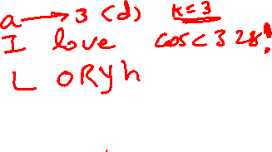
Simple encryption scheme
substitution cipher: substituting one thing for another
monoalphabetic cipher: substitute one letter for another
plaintext: abcdefghijklmnopqrstuvwxyz
ciphertext: mnbvcxzasdfghjklpoiuytrewq
e.g.:
Plaintext: bob. i love you. alice
ciphertext: nkn. s gktc wky. mgsbc
Encryption key: mapping from set of 26 letters
to set of 26 letters

Slide 12
A more sophisticated encryption approach
n substitution ciphers, M₁,M₂,…,M_{n}
cycling pattern:
e.g., n=4: M₁,M₃,M₄,M₃,M₂; M₁,M₃,M₄,M₃,M₂; ..
for each new plaintext symbol, use subsequent substitution pattern in cyclic pattern
dog: d from M₁, o from M₃, g from M₄
Encryption key: n substitution ciphers, and cyclic pattern
key need not be just n-bit pattern

Slide 13
Symmetric key crypto: DES
DES: Data Encryption Standard
US encryption standard [NIST 1993]
56-bit symmetric key, 64-bit plaintext input
block cipher with cipher block chaining
how secure is DES?
DES Challenge: 56-bit-key-encrypted phrase decrypted (brute force) in less than a day
no known good analytic attack
making DES more secure:
3DES: encrypt 3 times with 3 different keys

Slide 14
AES: Advanced Encryption Standard
symmetric-key NIST standard, replaced DES (Nov 2001)
processes data in 128 bit blocks
128, 192, or 256 bit keys
brute force decryption (try each key) taking 1 sec on DES, takes 149 trillion years for AES

Slide 15

Public Key Cryptography
symmetric key crypto:
requires sender, receiver know shared secret key
Q: how to agree on key in first place (particularly if never “met”)?
public key crypto
radically different approach [Diffie-Hellman76, RSA78]
sender, receiver do not share secret key
public encryption key known to all
private decryption key known only to receiver

Slide 16
Public Key Cryptography
+
Bob’s public key
K
B
-
Bob’s private key
K
B
plaintext
message, m
encryption
algorithm
ciphertext
decryption
algorithm
plaintext
+
-
+
K (m)
m = K (K (m))
B
B
B
Wow - public key cryptography revolutionized 2000-year-old (previously only symmetric key) cryptography!
similar ideas emerged at roughly same time, independently in US and UK (classified)

Slide 17
Public key encryption algorithms
requirements:
+
.
-
.
1
need K ( ) and K ( ) such that
B
B
-
+
K (K (m)) = m
B
B
+
2
given public key K , it should be impossible to compute private key K
B
-
B
RSA: Rivest, Shamir, Adelson algorithm

Slide 18
Prerequisite: modular arithmetic
x mod n = remainder of x when divide by n
facts:
[(a mod n) + (b mod n)] mod n = (a+b) mod n
[(a mod n) - (b mod n)] mod n = (a-b) mod n
[(a mod n) * (b mod n)] mod n = (a*b) mod n
thus
(a mod n)^{d} mod n = a^{d} mod n
example: x=14, n=10, d=2: (x mod n)^{d} mod n = 4² mod 10 = 6 x^{d} = 14² = 196 x^{d} mod 10 = 6

Slide 19
RSA: getting ready
message: just a bit pattern
bit pattern can be uniquely represented by an integer number
thus, encrypting a message is equivalent to encrypting a number
example:
m= 10010001. This message is uniquely represented by the decimal number 145.
to encrypt m, we encrypt the corresponding number, which gives a new number (the ciphertext).

Slide 20
RSA: Creating public/private key pair
1. choose two large prime numbers p, q. (e.g., 1024 bits each)
2. compute n = pq, z = (p-1)(q-1)
3. choose e (with e<n) that has no common factors with z (e, z are “relatively prime”).
4. choose d such that ed-1 is exactly divisible by z. (in other words: ed mod z = 1 ).
5. public key is (n,e). private key is (n,d).
+
-
K
K
B
B

Slide 21
RSA: encryption, decryption
0. given (n,e) and (n,d) as computed above
1. to encrypt message m (<n), compute
e
c = m mod n
2. to decrypt received bit pattern, c, compute
d
m = c mod n
magic happens!
e
d
m = (m mod n)
mod n
c

Slide 22
RSA example:
Bob chooses p=5, q=7. Then n=35, z=24.
e=5 (so e, z relatively prime).
d=29 (so ed-1 exactly divisible by z).
encrypting 8-bit messages.
m
e
e
bit pattern
m
c = m mod n
encrypt:
00001100
12
24832
17
d
d
c
c
m = c mod n
decrypt:
17
481968572106750915091411825223071697
12

Slide 23
Why does RSA work?
must show that c^{d} mod n = m, where c = m^{e} mod n
fact: for any x and y: x^{y} mod n = x^{(y mod z)} mod n
where n= pq and z = (p-1)(q-1)
thus, c^{d} mod n = (m^{e} mod n)^{d} mod n
= m^{ed} mod n
= m^{(ed mod z)} mod n
= m¹ mod n
= m

Slide 24
RSA: another important property
The following property will be very useful later:
-
+
+
-
K (K (m)) = m
=
K (K (m))
B
B
B
B
use public key first, followed by private key
use private key first, followed by public key
result is the same!

Slide 25
Why
-
+
+
-
K (K (m)) = m
=
K (K (m))
?
B
B
B
B
follows directly from modular arithmetic:
(m^{e} mod n)^{d} mod n = m^{ed} mod n
= m^{de} mod n
= (m^{d} mod n)^{e} mod n

Slide 26
Why is RSA secure?
suppose you know Bob’s public key (n,e). How hard is it to determine d?
essentially need to find factors of n without knowing the two factors p and q
fact: factoring a big number is hard

Slide 27
RSA in practice: session keys
exponentiation in RSA is computationally intensive
DES is at least 100 times faster than RSA
use public key crypto to establish secure connection, then establish second key – symmetric session key – for encrypting data
session key, K_{S}
Bob and Alice use RSA to exchange a symmetric session key K_{S}
once both have K_{S}, they use symmetric key cryptography

Slide 28
Chapter 8 outline
What is network security?
Principles of cryptography
Authentication, message integrity

Slide 29
Authentication
Goal: Bob wants Alice to “prove” her identity to him
Protocol ap1.0: Alice says “I am Alice”
“I am Alice”
failure scenario??

Slide 30
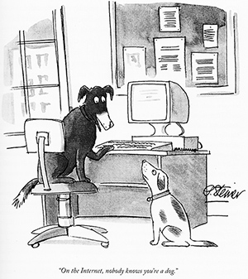
Authentication
Goal: Bob wants Alice to “prove” her identity to him
Protocol ap1.0: Alice says “I am Alice”
in a network, Bob can not “see” Alice, so Trudy simply declares herself to be Alice
“I am Alice”

Slide 31
Authentication: another try
Goal: Bob wants Alice to “prove” her identity to him
Protocol ap2.0: Alice says “I am Alice” in an IP packet containing her source IP address
Alice’s
IP address
“I am Alice”
failure scenario??

Slide 32
Authentication: another try
Goal: Bob wants Alice to “prove” her identity to him
Protocol ap2.0: Alice says “I am Alice” in an IP packet containing her source IP address
Trudy can create
a packet “spoofing”
Alice’s address
Alice’s
IP address
“I am Alice”

Slide 33
Authentication: a third try
Goal: Bob wants Alice to “prove” her identity to him
Protocol ap3.0: Alice says “I am Alice” Alice says “I am Alice” and sends her secret password to “prove” it.
Alice’s
IP addr
Alice’s
password
“I am Alice”
failure scenario??
Alice’s
IP addr
OK

Slide 34
Authentication: a third try
Goal: Bob wants Alice to “prove” her identity to him
Protocol ap3.0: Alice says “I am Alice” Alice says “I am Alice” and sends her secret password to “prove” it.
playback attack: Trudy records Alice’s packet
and later
plays it back to Bob
Alice’s
IP addr
Alice’s
password
“I am Alice”
Alice’s
IP addr
Alice’s
password
“I am Alice”
Alice’s
IP addr
OK

Slide 35
Authentication: a modified third try
Goal: Bob wants Alice to “prove” her identity to him
Protocol ap3.0: Alice says “I am Alice” Alice says “I am Alice” and sends her encrypted secret password to “prove” it.
Alice’s
IP addr
encrypted
password
“I am Alice”
failure scenario??
Alice’s
IP addr
OK

Slide 36
Authentication: a modified third try
Goal: Bob wants Alice to “prove” her identity to him
Protocol ap3.0: Alice says “I am Alice” Alice says “I am Alice” and sends her encrypted secret password to “prove” it.
Alice’s
IP addr
encrypted
password
“I am Alice”
playback attack still works: Trudy records Alice’s packet
and later plays it back to Bob
Alice’s
IP addr
encrypted
password
“I am Alice”
Alice’s
IP addr
OK

Slide 37
Authentication: a fourth try
Goal: avoid playback attack
nonce: number (R) used only once-in-a-lifetime
protocol ap4.0: to prove Alice “live”, Bob sends Alice nonce, R
Alice must return R, encrypted with shared secret key
“I am Alice”
R
K (R)
Bob know Alice is live, and only Alice knows key to encrypt nonce, so it must be Alice!
A-B
Failures, drawbacks?

Slide 38
Authentication: ap5.0
ap4.0 requires shared symmetric key - can we authenticate using public key techniques?
ap5.0: use nonce, public key cryptography
“I am Alice”
R
Bob computes
+
-
-
K
(K (R)) = R
K (R)
A
A
A
and knows only Alice could have the private key, that encrypted R such that
Send me your public key
+
K (R)
+
-
A
K
A
(K (R)) = R
A

Slide 39
Authentication: ap5.0 – there’s still a flaw!
man (or woman) in the middle attack: Trudy poses as Alice (to Bob) and as Bob (to Alice)
I am Alice
I am Alice
?
R
-
K (R)
T
R
Where are mistakes made here?
Send me your public key
-
+
K (R)
K
Bob computes
A
T
+
-
Send me your public key
K
(K (R)) = R,
+
T
T
K
authenticating
Trudy as Alice
A
Trudy recovers m:
+
+
-
+
K (m)
Trudy recovers Bob’s m:
m = K (K (m))
Bob sends a personal message, m to Alice
-
+
K (m)
T
T
m = K (K (m))
A
T
A
A
sends m to Alice encrypted with Alice’s public key
and she and Bob meet a week later in person and discuss m, not knowing Trudy knows m
Notes:
…
so the question is where are the mistakes in this protocol how can we fix this?

Slide 40
Chapter 8 outline
What is network security?
Principles of cryptography
Authentication, message integrity
Securing e-mail
Securing TCP connections: TLS
Network layer security: IPsec
Security in wireless and mobile networks
Operational security: firewalls and IDS

Slide 41

Digital signatures
cryptographic technique analogous to hand-written signatures:
sender (Bob) digitally signs document: he is document owner/creator.
verifiable, nonforgeable: recipient (Alice) can prove to someone that Bob, and no one else (including Alice), must have signed document
simple digital signature for message m:
Bob signs m by encrypting with his private key K_{B}, creating “signed” message, K_{B}⁻(m)
-
Bob’s private
key
-
Bob’s message, m
K
m,K
(m)
B
B
Dear Alice
Oh, how I have missed you. I think of you all the time! …(blah blah blah)
Bob
Dear Alice
Oh, how I have missed you. I think of you all the time! …(blah blah blah)
Bob
Public key
encryption
algorithm
-
K
(m)
B

Slide 42
Digital signatures
-
suppose Alice receives msg m, with signature: m, K_{B}(m)
Alice verifies m signed by Bob by applying Bob’s public key K_{B} to K_{B}(m) then checks K_{B}(K_{B}(m) ) = m.
If K_{B}(K_{B}(m) ) = m, whoever signed m must have used Bob’s private key
+
-
+
-
+
-
Alice thus verifies that:
Bob signed m
no one else signed m
Bob signed m and not m’
non-repudiation:
Alice can take m, and signature K_{B}(m) to court and prove that Bob signed m
-

Slide 43
Message digests
computationally expensive to public-key-encrypt long messages
goal: fixed-length, easy- to-compute digital “fingerprint”
apply hash function H to m, get fixed size message digest, H(m)
large
message
m
H: Hash
Function
H(m)
Hash function properties:
many-to-1
produces fixed-size msg digest (fingerprint)
given message digest x, computationally infeasible to find m such that x = H(m)

Slide 44
Digital signature = signed message digest
Bob sends digitally signed message:
Alice verifies signature, integrity of digitally signed message:
large
message
m
H: Hash
Function
H(m)
encrypted
message digest
-
K_{B}(H(m))
digital
signature
(encrypt)
Bob’s
private
key
large
message
m
-
K
B
digital
signature
(decrypt)
Bob’s
public
key
+
encrypted
message digest
H: Hash
function
K
B
+
-
K_{B}(H(m))
H(m)
H(m)
?
equal

Slide 45
Hash function algorithms
MD5 hash function widely used (RFC 1321)
computes 128-bit message digest in 4-step process.
arbitrary 128-bit string x, appears difficult to construct msg m whose MD5 hash is equal to x
SHA-1 is also used
US standard [NIST, FIPS PUB 180-1]
160-bit message digest

Slide 46
End of the course!
Final Exam date
Saturday, Dec 11th, 2021
@8:30 AM
Best of Luck in the final exam!

